Slide 1
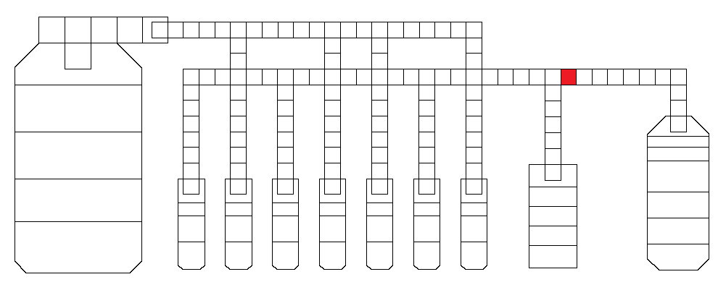
Dead electrode (could also be the one to the right)
Fridge: http://baebies-dev/fridge/run/6387
Video: MVI_0015: 3:13, 11:48, 18:20, 24:45, etc
Cartridge # X04935
Pins 88, 87

Slide 2
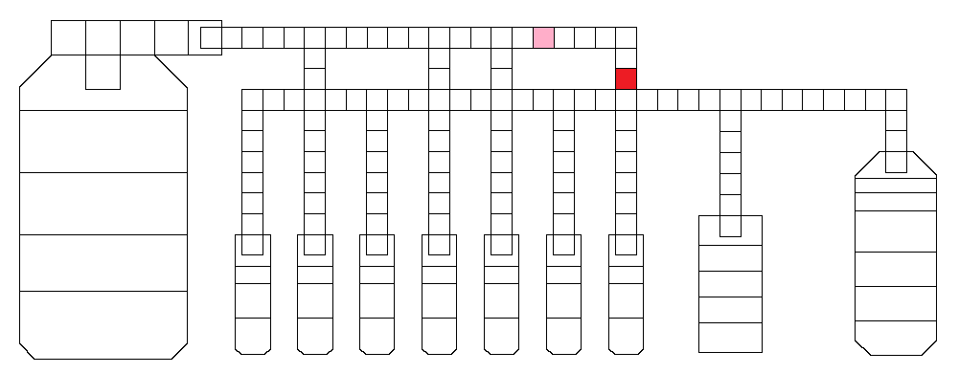
Dead electrode – pink is bussed
Fridge: http://baebies-dev/fridge/run/6504
Video: MVI_0071, 7:15 , 9:22, 13:50
Cartridge # X06651

Slide 3
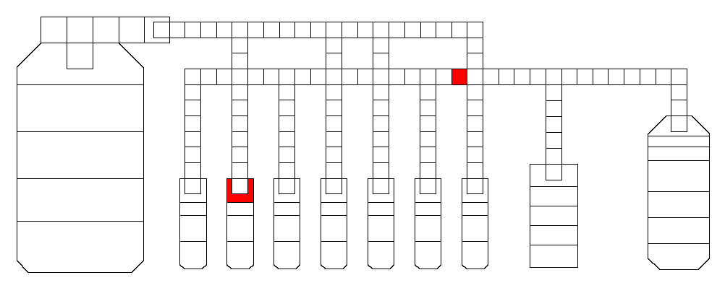
Dispense and transporting issues
http://baebies-dev/fridge/run/6419
Pins 26 & 76
Run on 11/1/17
Notes:
Lisa

Slide 4
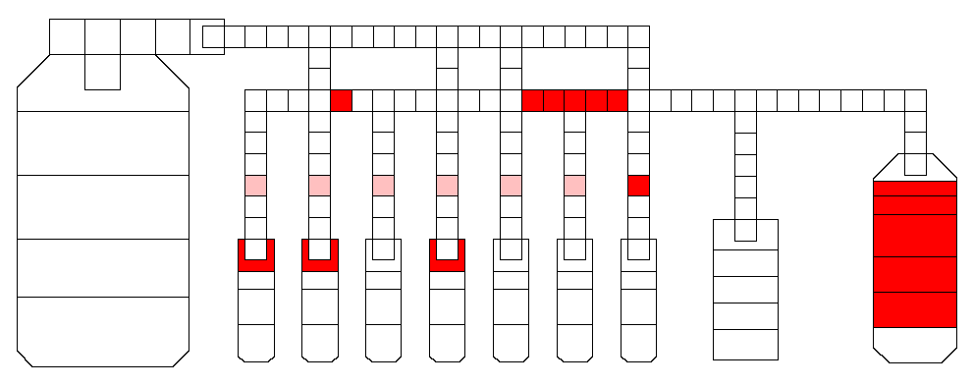
Dispensing Issues in lanes and Suspected Short in Reservoir
http://baebies-dev/fridge/run/6421
Pretty much anywhere
Run on 11/1/17

Slide 5
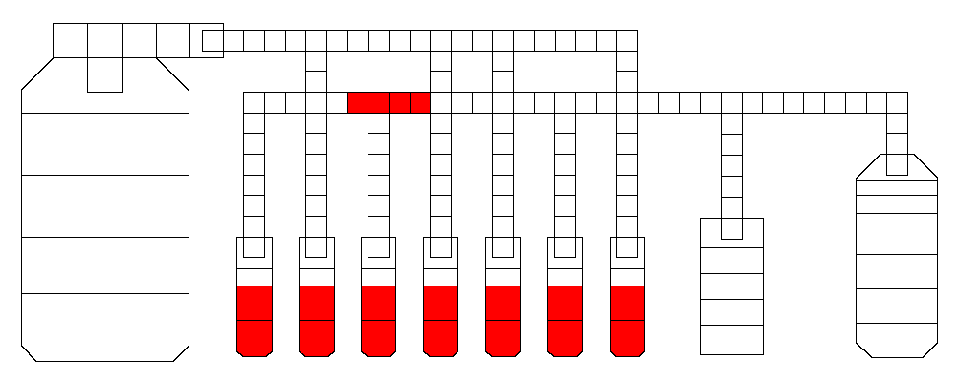
Dispensing Issues and Transporting issues
http://baebies-dev/fridge/run/6432
Run on 11/2/17

Slide 6
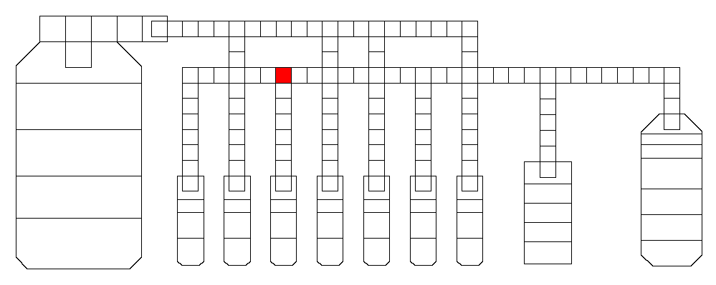
Transporting issue
http://baebies-dev/fridge/run/6434
Run on 11/2/17

Slide 7
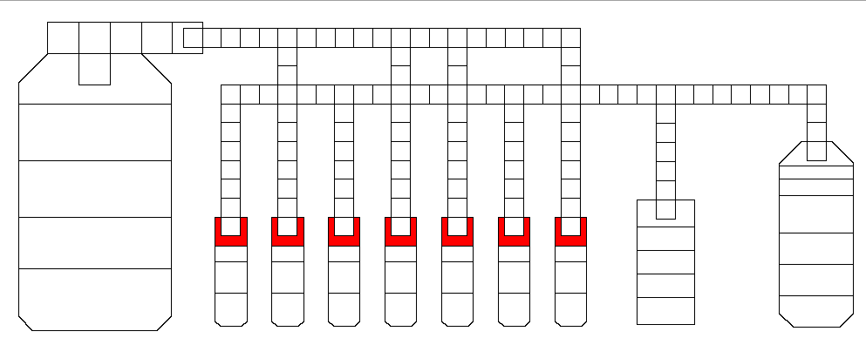
Dispensing Issue
http://baebies-dev/fridge/run/6441
Run on 11/3/17

Slide 8
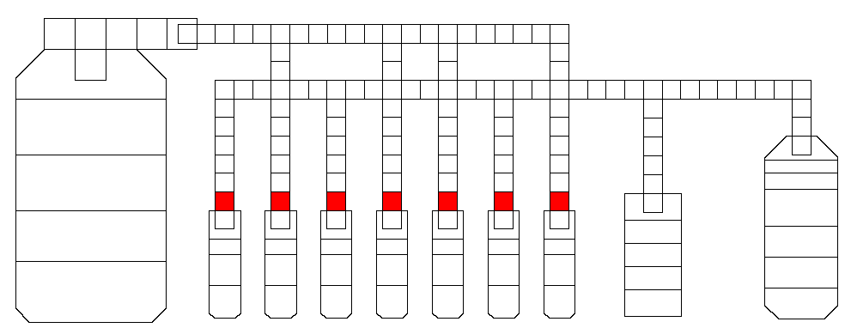
Dispensing Issue
http://baebies-dev/fridge/run/6463
Run on 11/3/17

Slide 9
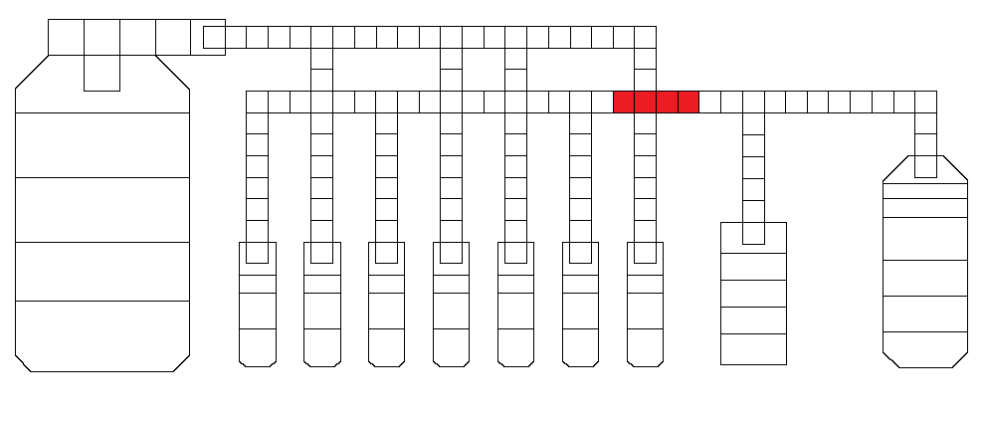
Dead electrode (somewhere there… I forgot to move the video from my HD)
Fridge: http://baebies-dev/fridge/run/6740
No video
Cartridge # X05795

Slide 10
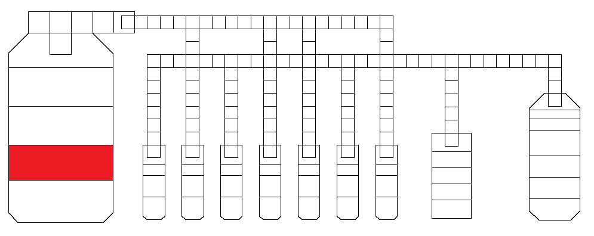
Dead electrode
Fridge: http://baebies-dev/fridge/run/6742
Cartridge # X05797
I did not take video for this one because it was obvious upon loading

Slide 11
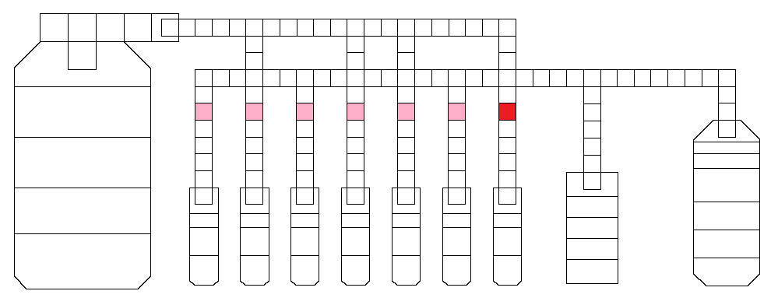
Dead electrode (pink are bussed)
Fridge: http://baebies-dev/fridge/run/6763
Video: Fridge Run 6763 (short video)
Cartridge # X05788

Slide 12
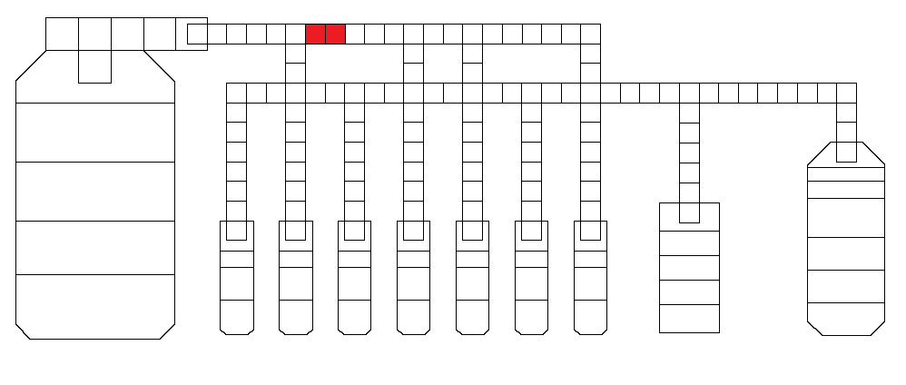
Dead electrode (could also be the one to the right)
Fridge: http://baebies-dev/fridge/run/6894
Video: MVI_1255: 0:57
Cartridge # X05487

